Slide 1
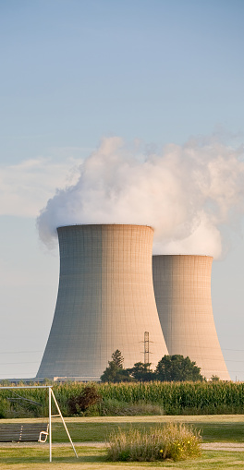
The Green Stealers
Turning Data Overload into Data Clarity

Slide 2




Energy decision makers are overwhelmed with data
Little Insights

Slide 3

Sphinx AI can turn this chaos into fast, data-informed decisions
Sphinx AI
Maximum Insights

Slide 4






Meet the Green Stealers
Sam Henry
Sana Shetty
Business Analyst
Chief Engineer
Vashishth Doshi
Data Scientist

Slide 5




The Capabilities that Drive Better Decisions
Identify underperforming power plants
Understand how external market conditions impact operations and margins - understand the macro.
Evaluate the effects of carbon emissions and analyse risk
Pinpoint exactly where errors occur in the process flowsheet - understand the micro.

Slide 6
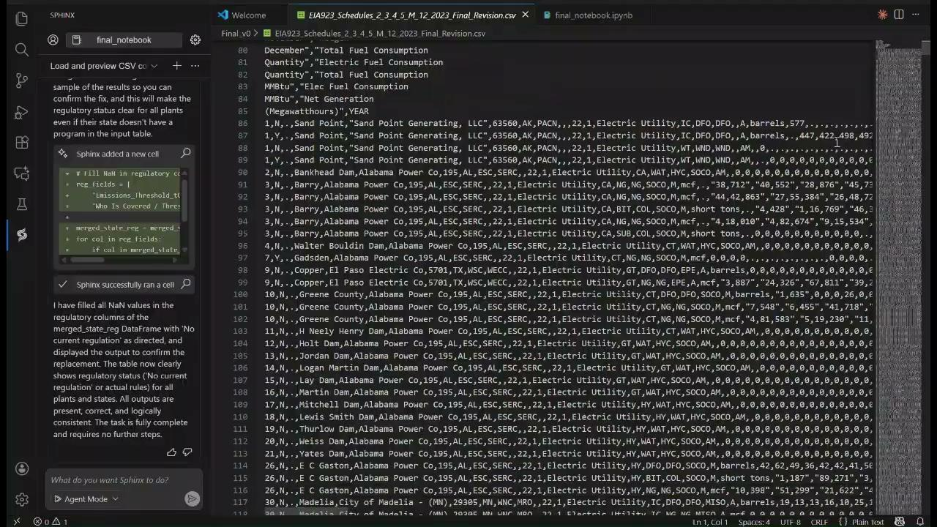
4 Step AI-CoPilot

Slide 7
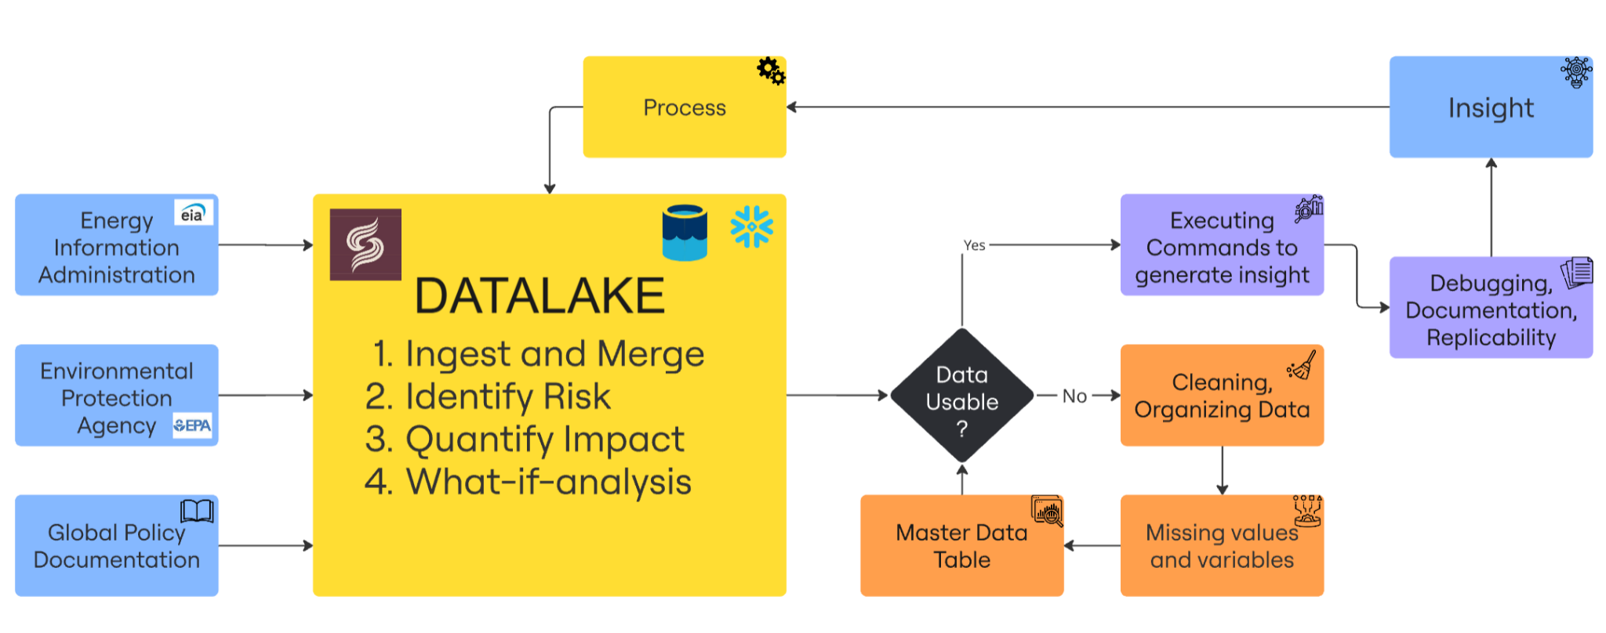
Sphinx AI-Powered Workflow

Slide 8
Next Steps - Generalizing our capabilities for the world.
Implement real-time monitoring of processes
Integrate predictive modeling to forecast performance and market impacts
Expand to other industries like steel, cement, and chemicals

Slide 9
With Sphinx AI, raw datasets can be analyzed quickly to generate valuable insights
Identify underperforming assets
Assess carbon policy and emissions impacts
Diagnose process breakdown
Quantify the impact of changing market conditions

Slide 10
Thank You
Questions?

